Slide 1
TIME-DOMAIN PITCH ESTIMATION USING AMDF
Instructor: Dr. Ninh Khanh Duy
Nguyen Phi Truong
Student ID: 102210082
Class: 21TCLC_DT1

Slide 2
Table of content
1. Problem
2. Algorithm
3. Experimental results
4. Conclusions

Slide 3
Problem
1

Slide 4
Input: Random audio of voice contains voiced,
unvoiced, silent signal
Output: Estimate fundamental pitch
F0 mean and F0 std, plot the F0 contour and
AMDF of voiced, unvoiced frame
Constraint: The variability of people’s fundamental frequency
is 70 – 400 Hz

Slide 5
Algorithm
2
Finding F0: using short-term average magnitude difference function (AMDF)
Smoothing F0 contour: using median filter
Finding local minimum dips
Finding VU discrimination threshold

Slide 6
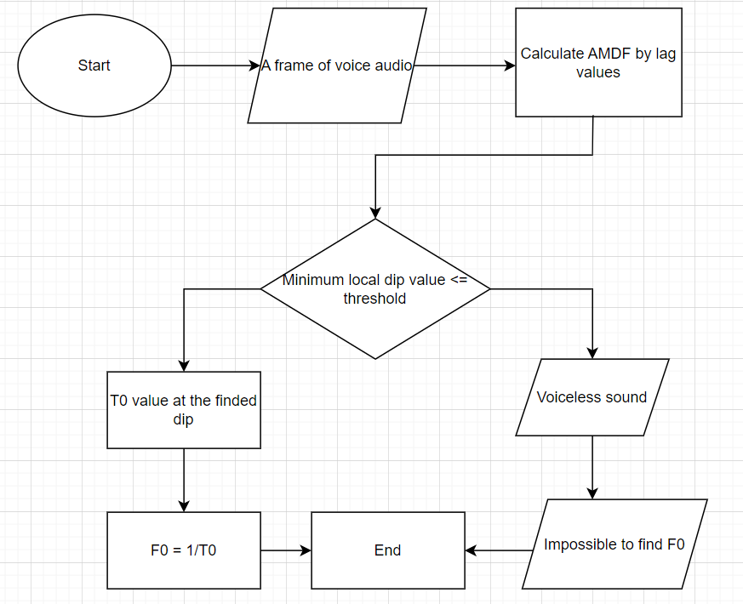

Slide 7
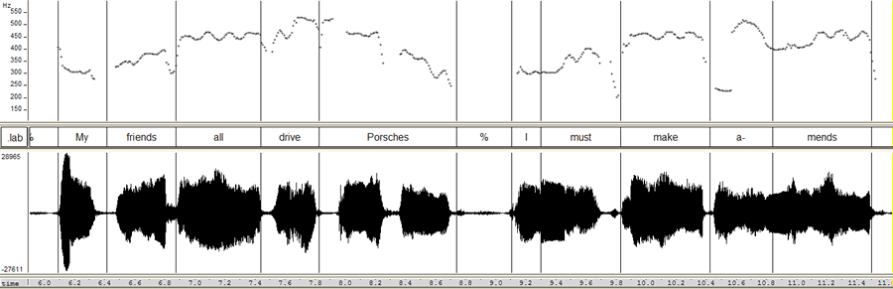
Median filter

Slide 8
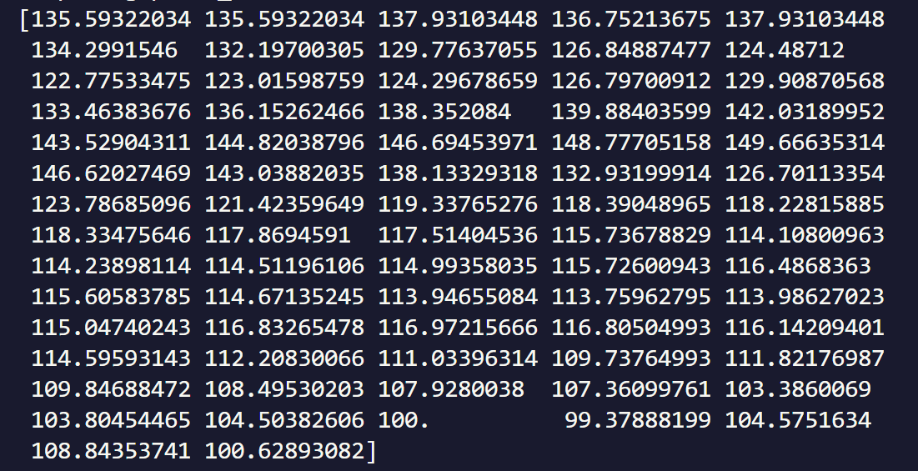

Median filter
Observation: The neighborhood pitch won’t shift too much from each other
The pitch which has too much shift from its neighborhood pitch is virtual pitch

Slide 9
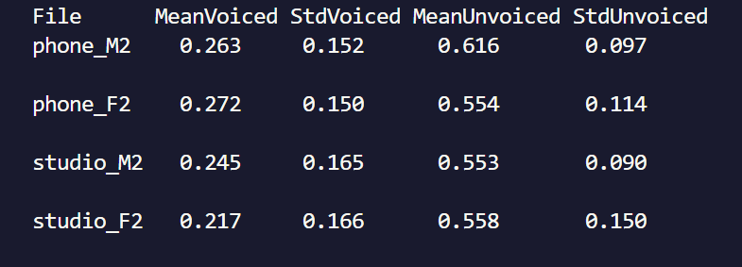
Finding VU discrimination threshold

Slide 10
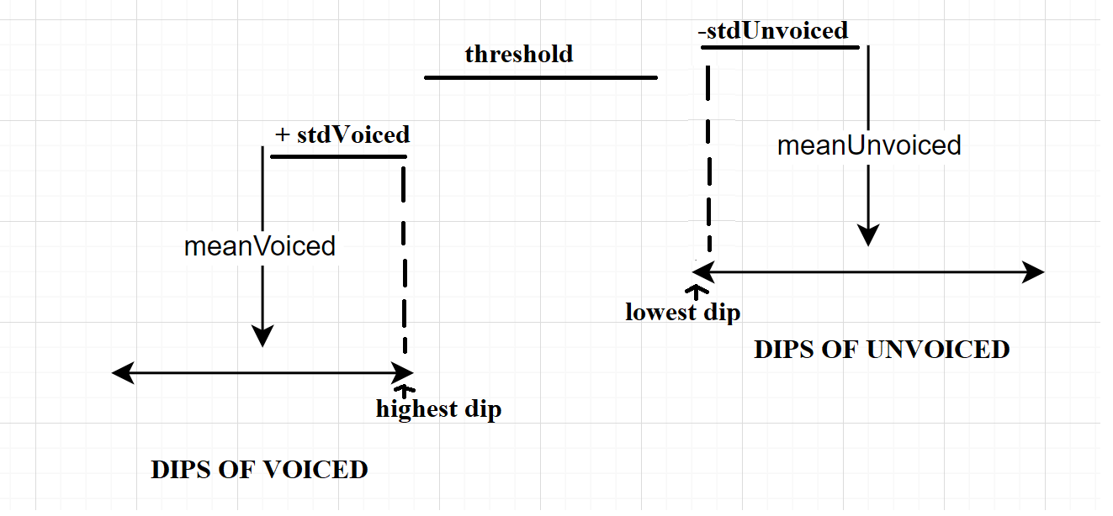

Slide 11

Threshold = avg(highest dip of voiced, lowest dip of unvoiced
Threshold must be between highest dip of voiced and lowest dip of unvoiced
Taking average of all audio training input threshold, we have the final threshold to discriminate VU

Slide 12
File | MeanVoiced | StdVoiced | MeanUnvoiced | StdUnvoiced | (meanVoice + stdVoice + meanSilent - stdSilent) / 2
Phone_M2 | 0.263 | 0.152 | 0.616 | 0.697 | 0.467
Phone_F2 | 0.272 | 0.150 | 0.554 | 0.114 | 0.431
Studio_M2 | 0.245 | 0.165 | 0.553 | 0.090 | 0.436
Studio_F2 | 0.217 | 0.166 | 0.558 | 0.150 | 0.395
Threshold = AVG(COLUMN(6)) |  |  |  |  | 0.4325

Slide 13
Experimental results
3

Slide 14
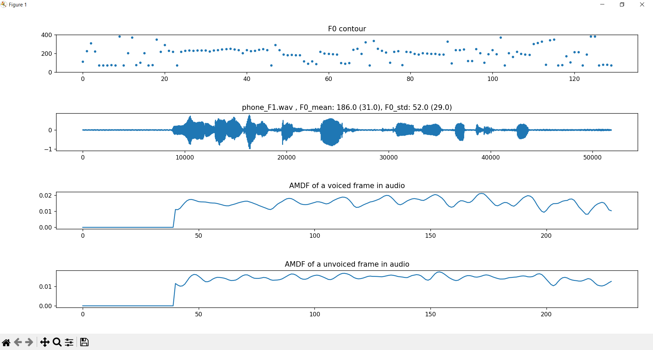

Slide 15
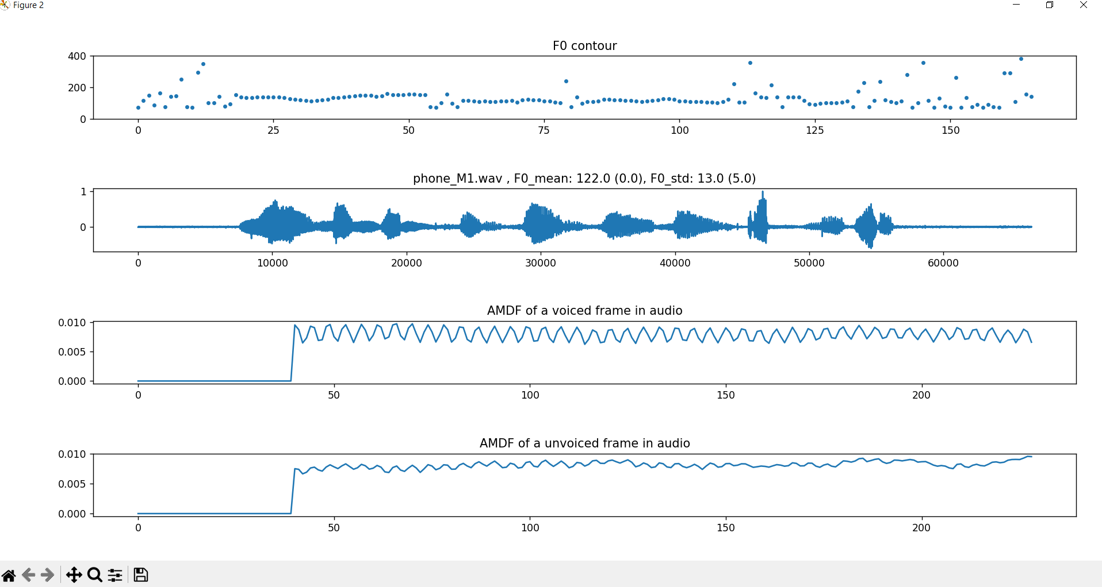

Slide 16
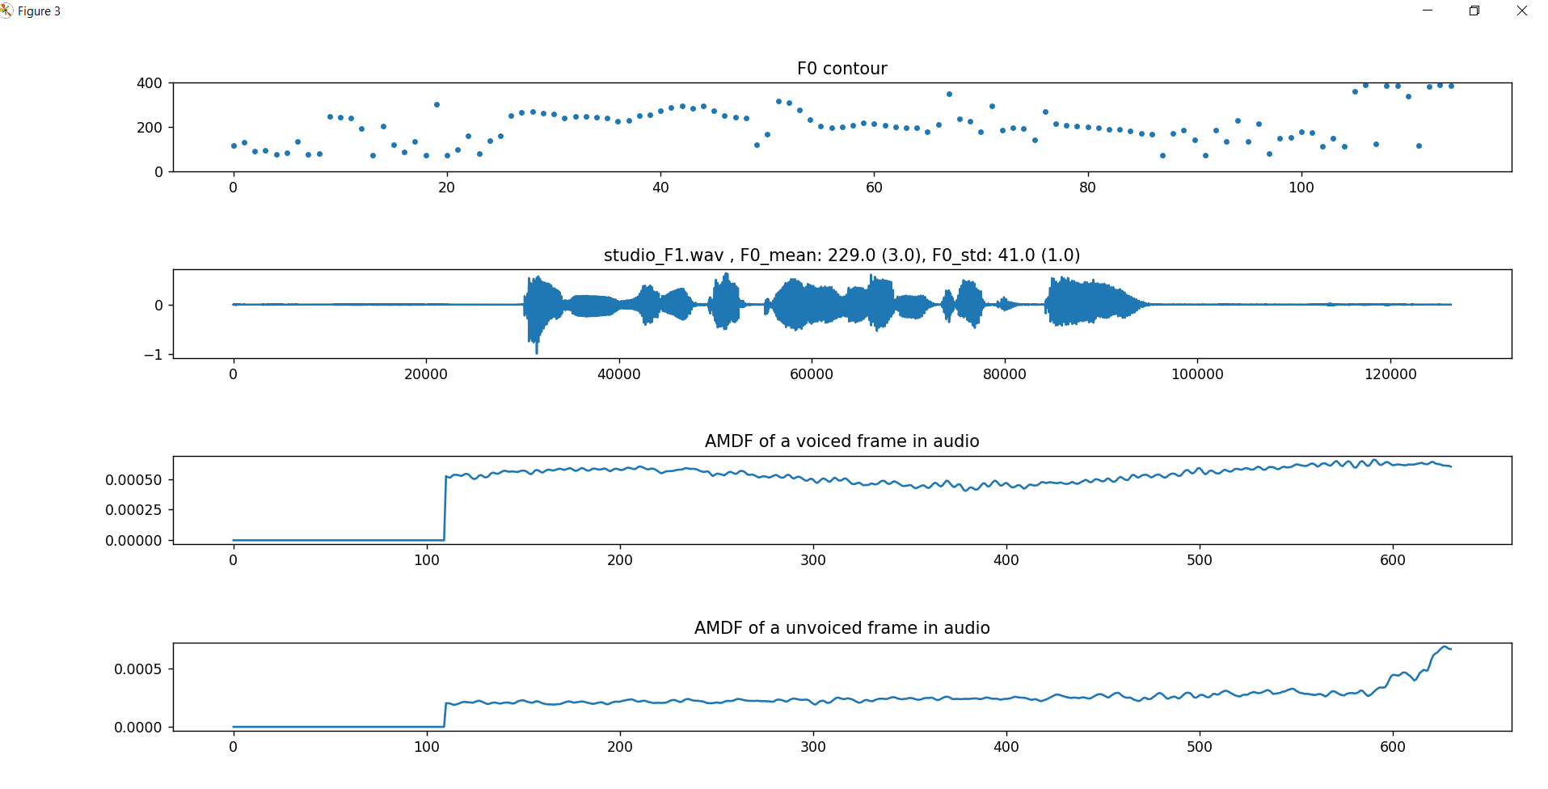

Slide 17
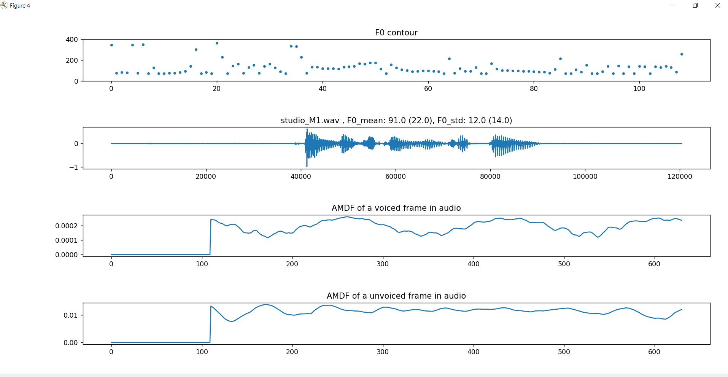

Slide 18
File | Type | AMDF (Hz) | Lab (Hz) | Relative error (%)
Phone_F1 | F0 mean | 186 | 217 | 14.29
 | F0 std | 52 | 23 | 126.09
Phone_M1 | F0 mean | 122 | 122 | 0
 | F0 std | 13 | 18 | 27.78
Studio_F1 | F0 mean | 229 | 232 | 1.29
 | F0 std | 41 | 40 | 2.5
Studio_M1 | F0 mean | 91 | 113 | 19.47
 | F0 std | 12 | 26 | 53.85

Slide 19
Lowest F0 mean relative error: Phone_M1 (0%)
Lowest F0 std relative error: Studio_F1 (2.5%)
Highest F0 mean relative error: Studio_M1 (19.47%)
Highest F0 std relative error: Phone_F1 (126.09%)
Studio_F1 has the best result: F0 mean relative error (1.29%) and F0 std relative error (2.5%)
Phone_F1 has the worst result: F0 mean relative error (14.29%) and F0 std relative error (126.09%)

Slide 20
Conclusions
3

Slide 21
The median filter is only efficient when filling out the isolated pitch, when there are multiple neighboring pitchs the function became less efficient thus it can not filter out all virtual pitchs
=> Find a way to handle multiple neighboring pitchs

Slide 22
The discrimination threshold is not accurate with all audio input
=> Find a way to automate the finding threshold process (maybe using statistic distribution …)

Slide 23
Thanks!

